Slide 1







Enterprise Blockchain Developers (Intermediate)
In support of
Powered By

Slide 2
Outline
Introduction to Uniswap App
How To Fork Uniswap
Factory Pattern and Proxy
Demo: How to Write a Simple Factory and Store Contract using openzeppelin
Use scripts to depoly Contracts
Writing test cases
RISmarket-NFT Example
© 2017-2020 SmartMesh Foundation Pte. Ltd. | MeshBox Foundation Pte. Ltd.

Slide 3
Introduction to Uniswap App
What is Uniswap? Dex
Bond cruving
automatic market making
Pros and Cons
risky for the market maker
need liqudity pool
easy to use for inidvidual traders

Slide 4
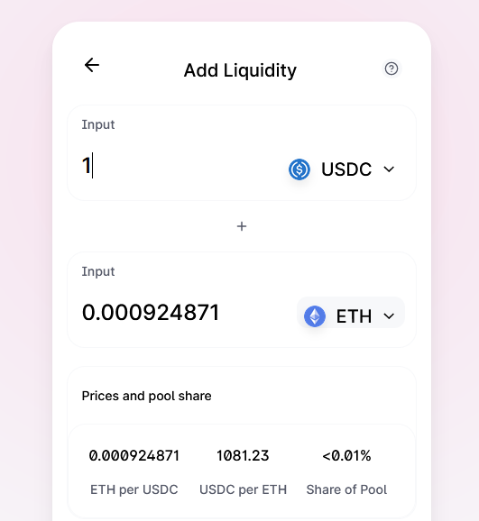
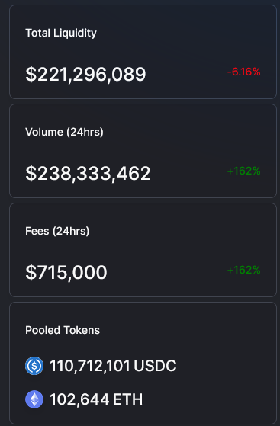
Liqudity Pool

Slide 5
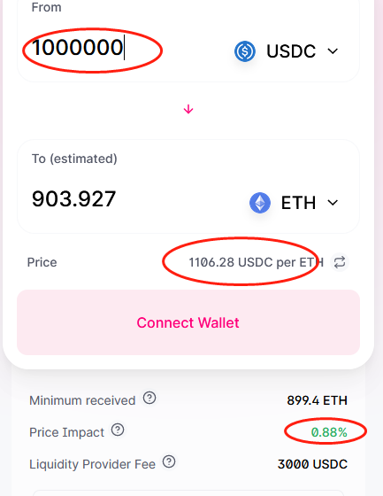
Swap

Slide 6
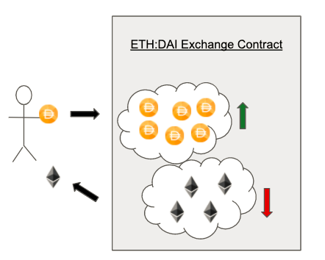
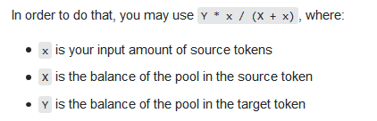
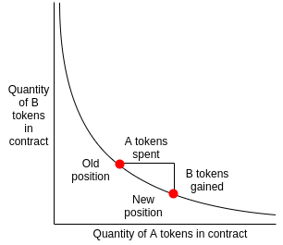
Liqudity Pool
How to price the token

Slide 7
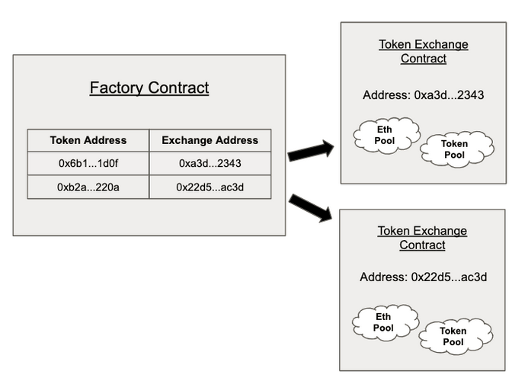
Overview of Uniswap’s Contracts
Exchange contract: Exchange contracts hold a pool of a specific token and Ether that users can swap against.
Factory contract which is in charge of creating new Exchange contracts and registering the ERC20 token address to its Exchange contract address.

Slide 8
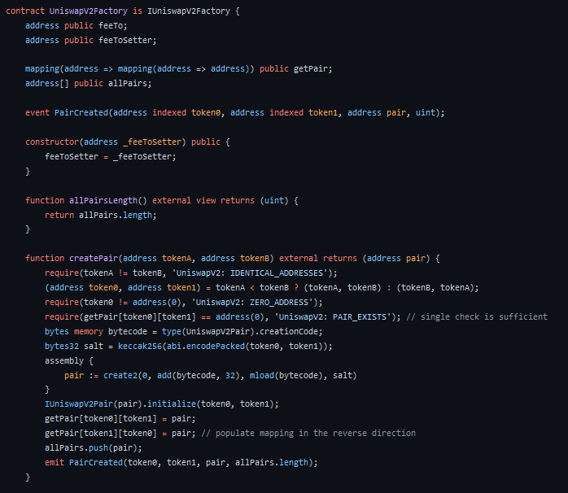
Uniswap Contracts

Slide 9
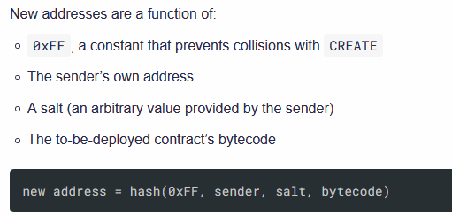
Uniswap Contracts
The CREATE2 opcode gives us the ability predict the address where a contract will be deployed, without ever having to do so
IUniswapV2Pair(pair).initialize(token1,token2) : when you call functions on that contract, they should be sent to the address pair.
use type(aa).creationCode to create a new contract
keccak256(bytes memory) returns (bytes32) − computes the Keccak-256 hash of the input.

Slide 10
Uniswap Fork Demo
Demo

Slide 11
Factory and Proxy Pattern
What Is the Factory Pattern?
The idea of the factory pattern is to have a contract (the factory) that will carry the mission of creating other contracts.
Why Use the Factory Pattern in Solidity?
1 If you want to create multiple instances of the same contract and you’re looking for a way to keep track of them and make their management easier.
2 Save gas on deployment: You can deploy only the factory and use it later to deploy the other contracts.
3 Improve contract security: make logic simpler, upgradeable, so safer.

Slide 12
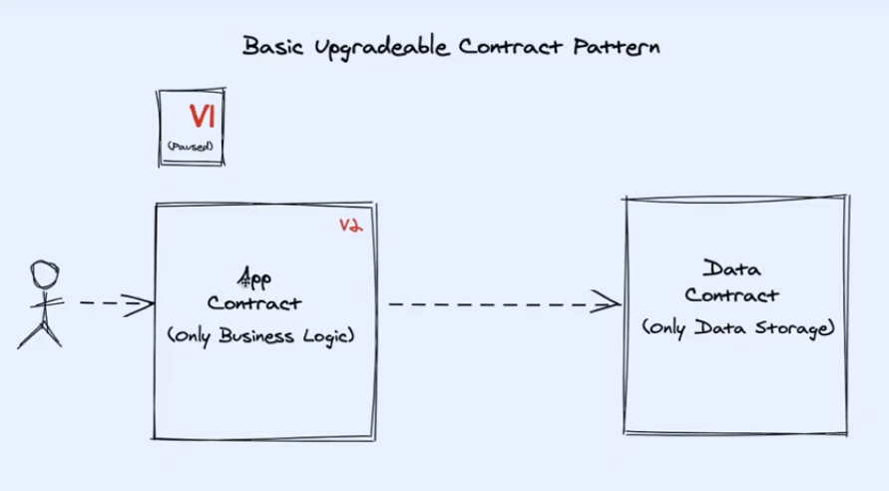
Factory and Proxy Pattern

Slide 13
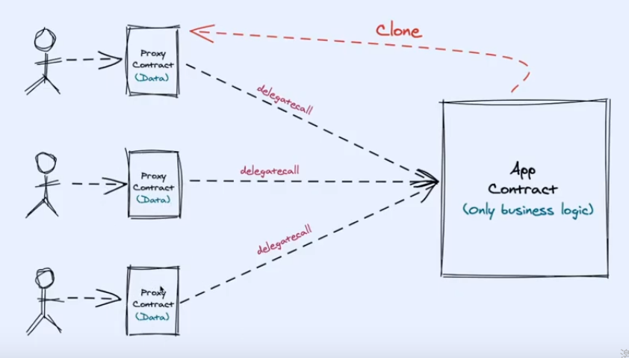
Factory and Proxy Pattern

Slide 14
Factory and Proxy Pattern: Openzeppelin
What Is the Factory Pattern?
The idea of the factory pattern is to have a contract (the factory) that will carry the mission of creating other contracts.
Why Use the Factory Pattern in Solidity?
1 If you want to create multiple instances of the same contract and you’re looking for a way to keep track of them and make their management easier.
2 Save gas on deployment: You can deploy only the factory and use it later to deploy the other contracts.
3 Improve contract security: make logic simpler, upgradeable, so safer.

